Slide 1
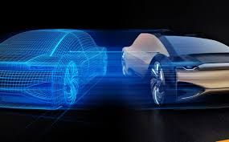




The Progression of Electric Vehicles
(WA)
By Riffat Adnan, Jenique Fahie, Prachi Patel and Thomas Sullivan

Slide 2
About Our Dataset
We chose our dataset from the website Kaggle.
It is based on data for the electric vehicle population in the state of Washington.
Our data ranges from 1997 through 2025 and we utilized upwards of 165,000 unique rows.(condensed to 2023)
We chose this dataset to study the rise of electric vehicles throughout the 21st century.

Slide 3
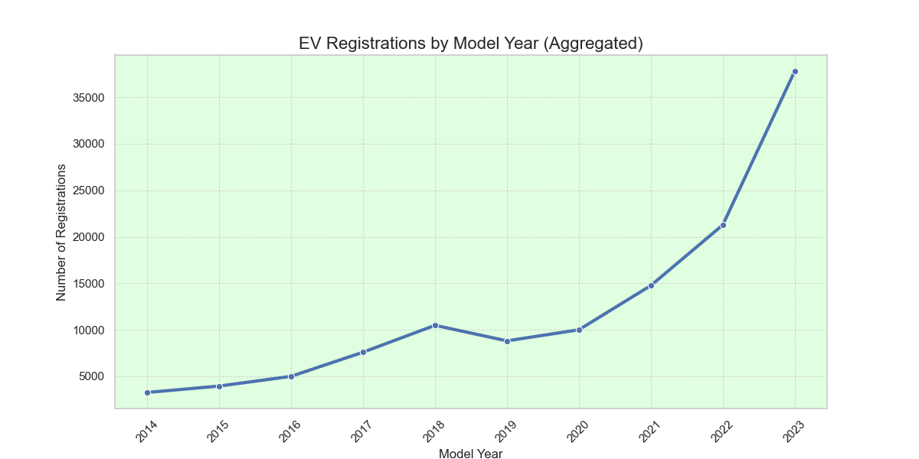
Electric Vehicles in Washington
This graph highlights the rapid growth of EV’s over the last decade
By end of 2023, we now have over 168,000 EV’s in WA alone.
Between 2022 and 2023 the number of EV registrations surged from 21,275 to 37,806—a remarkable 77.7% increase in just one year.

Slide 4
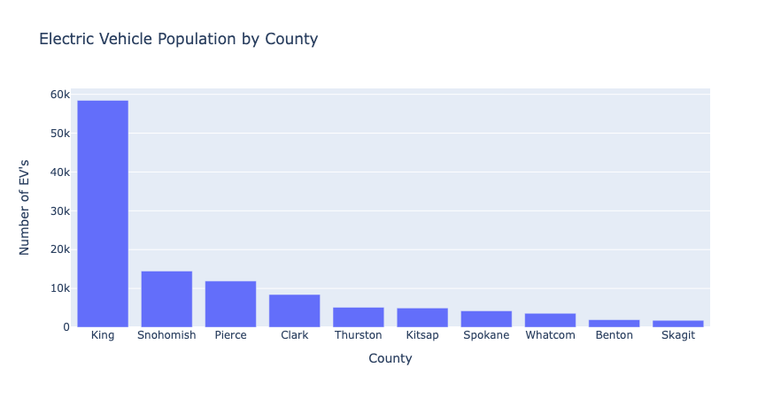
Electric Vehicles by County
The data shown, displays our most dense EV areas in the state.
Electric vehicles seem to be very popular in areas with large cities.

Slide 5
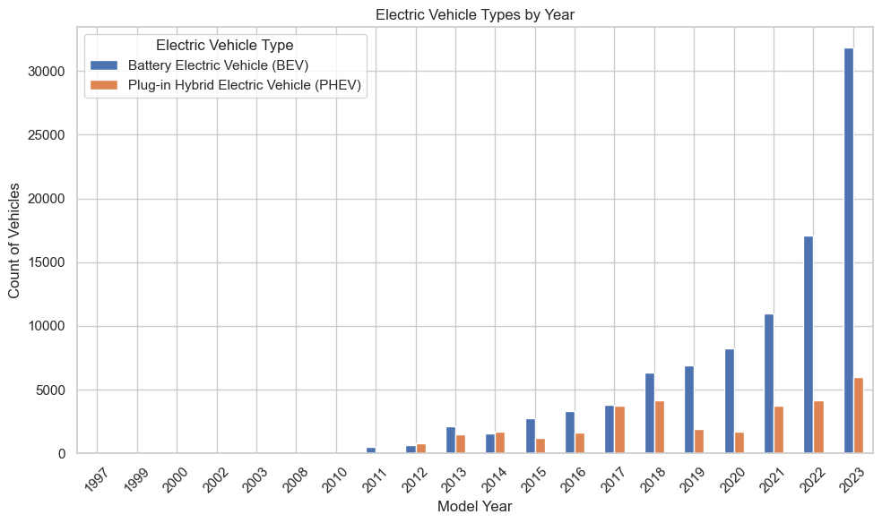
BEV’s vs. PHEV’s
chain disruptions.
Steady Growth: EV adoption grows over time, with early years showing fewer models and limited tech.
BEV Dominance: Recent years show a strong shift to Battery Electric Vehicles (BEVs).
PHEV Decline: Plug-in Hybrids (PHEVs) slow as BEVs become more affordable and offer better range.
Peaks and Dips: Peaks reflect popular launches and policies; dips may result from economic or supply chain issues.

Slide 6
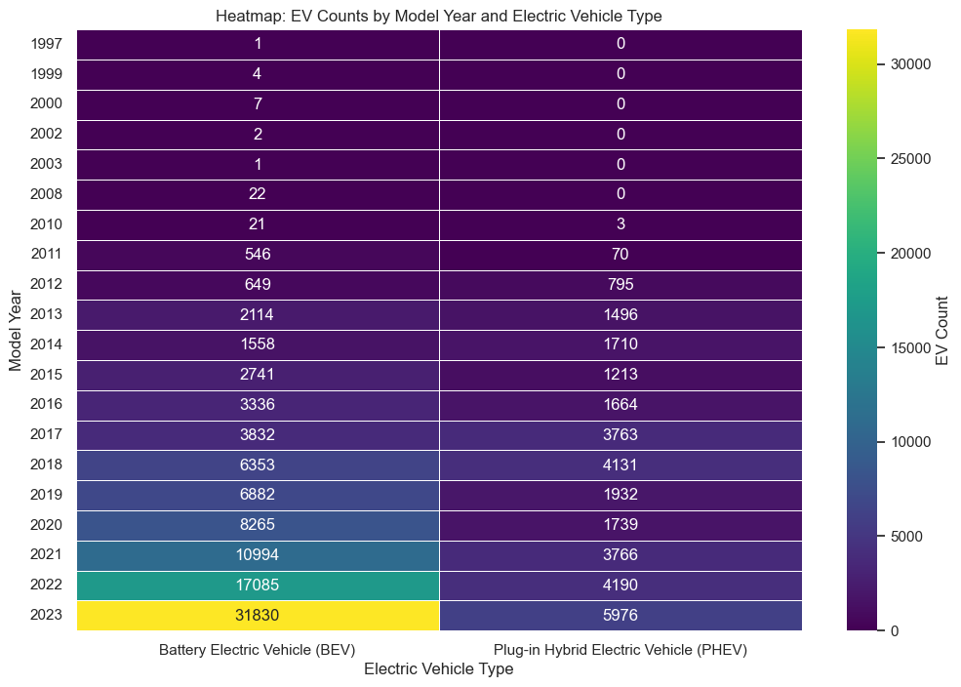
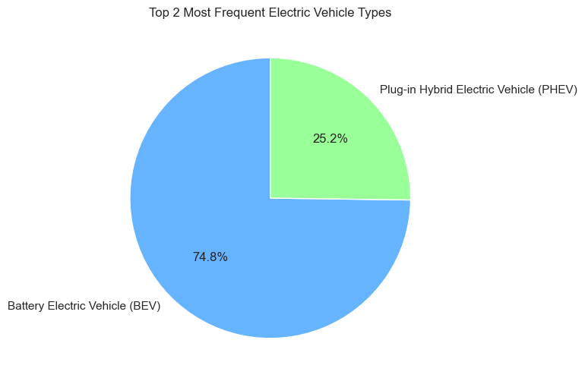
BEV’s vs. PHEV’s Cont.
Pie Chart:
Market Split: Highlights the proportion of top EV types.
BEV Dominance: Larger slice reflects a strong shift to BEVs.
PHEV Role: Smaller slice shows transitional appeal of PHEVs.
Consumer Preference: Visualizes preference for advanced EV tech.
Heat Map:
Focus on EV Types: Highlights the two most common EV types.
BEV Dominance: BEVs lead, likely due to zero emissions and improved range.
PHEV Popularity: PHEVs cater to consumers seeking fuel flexibility.
Market Insight: Shows trends in consumer preferences and EV market share.

Slide 7
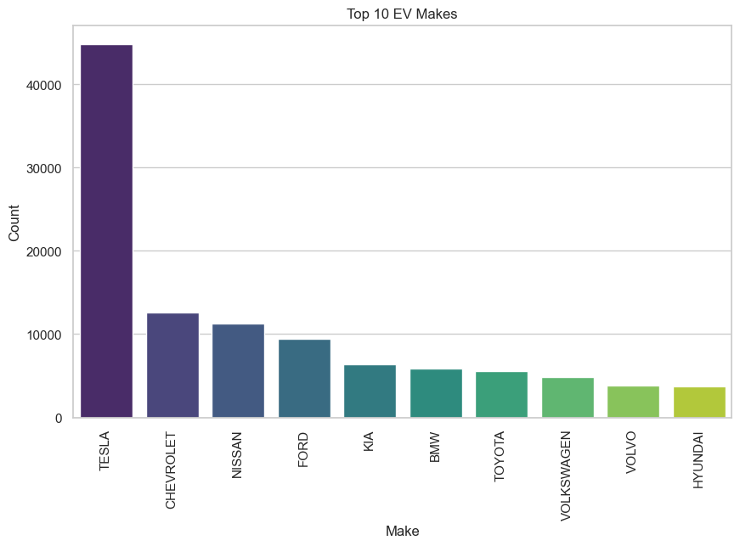
Most Popular Companies (Make)
The bar plot highlights the top 10 most popular EV makes, with Tesla likely leading due to its innovation and widespread infrastructure.
Other makes like Nissan and Chevrolet follow, reflecting their affordability and early market entry.
The steep decline among lower-ranked makes shows market dominance by a few key players.

Slide 8
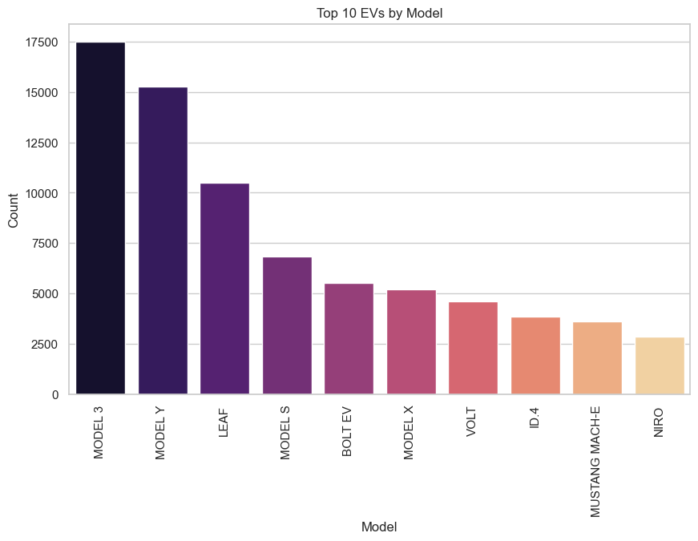
Most Popular Companies (Model)
Tesla holds 4 out of top 10 spots, showcasing its leadership and dominance in Ev market.
Brands like Nissan are making significant progress with standout models, such as the Nissan Leaf.
The market is diversifying, with more brands creating more models to compete with Tesla.

Slide 9
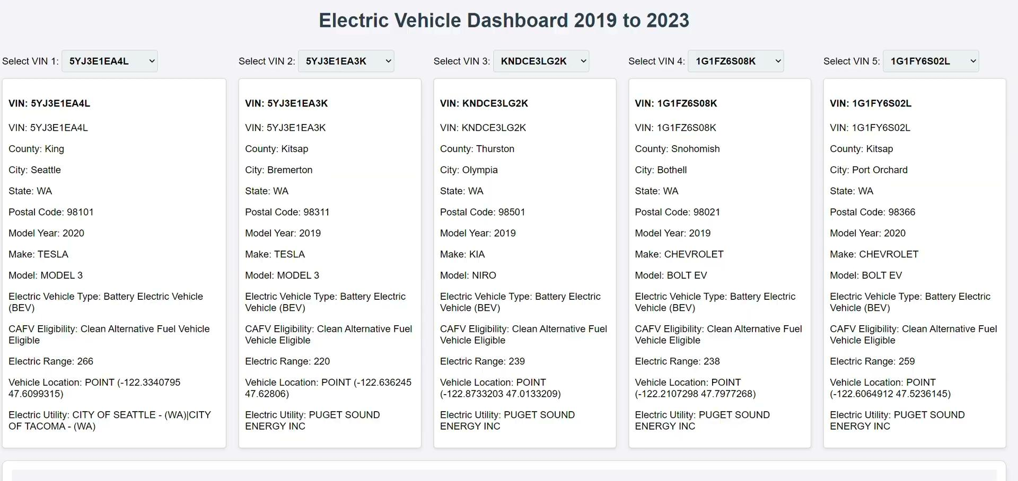
Electric Vehicle Dashboard
The data contains details about electric vehicles (EVs), focusing on their electric range, make, model, and other performance metrics.
Each record includes:A Vehicle Identification Number (VIN), make and model of the EV & electric range in miles.
The data allows users to compare EVs side by side, helping them understand how vehicles differ in terms of range and other key specifications.
The dashboard fetches this data to display bar charts for electric range comparisons & detailed metadata for selected VINs, such as make, model, and range.

Slide 10
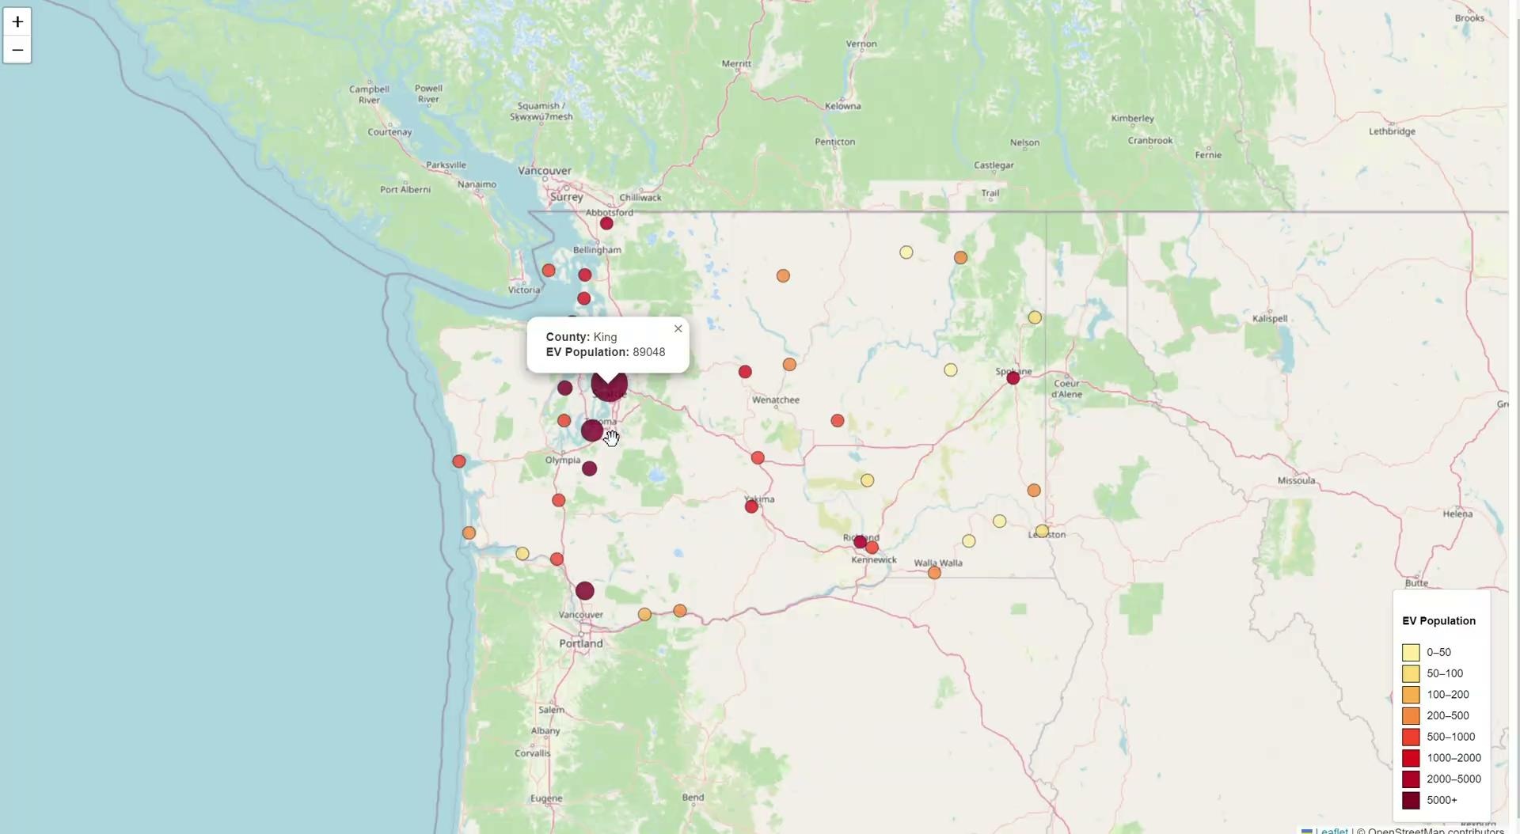
Map of EV Population in WA State
Purpose: The map visualizes EV population data by county.
Markers: Each county is shown as a circle marker, with size and color based on the EV population.
Pop Ups: Clicking a marker shows the county name and EV population.
Legend: A color-coded legend explains population ranges.
Interactivity: The map auto-zooms and adjusts to fit all counties dynamically.

Slide 11
Conclusion
Rapid Growth: EV adoption in Washington State has surged over the past decade, with significant increases between 2022 and 2023.
Regional Leadership: King , Snohomish, and Pierce counties drive adoption due to large population density.
Dominance of BEVs: Battery Electric Vehicles now make up 74.8% of all EV registrations.
Tesla’s Leadership: Tesla’s Model 3 and Model Y is leading in popularity, making Tesla the top EV manufacturer.
This growth highlights a strong movement toward the widespread acceptance of EVs in Washington state.

Slide 12
References
https://www.kaggle.com/datasets/mariusborel/electric-vhicule-population-data
https://leafletjs.com/examples/quick-start/
https://leafletjs.com/examples.html

Slide 13

Questions
Questions
Questions
Questions
Questions
Questions
Questions
Questions
Questions
Questions
Questions

